Slide 1
Welcome Reception Parents

Slide 2



Learning in the Early Years
In the Early Years we are building the foundations for future learning, we do this predominantly through play, using a combination of carefully planned adult led and child-initiated activities.
We aim to provide an environment that encourages engaged, motivated children to develop into successful lifelong learners.
“Play is the highest form of research.”
-Albert Einstein

Slide 3
Curriculum
We follow the Early Years Foundation Stage Curriculum, information on this can be found on the government website by searching
EYFS statutory framework 2021
The Foundation Stage curriculum consists of seven areas of learning:-
three Prime areas and four Specific areas

Slide 4
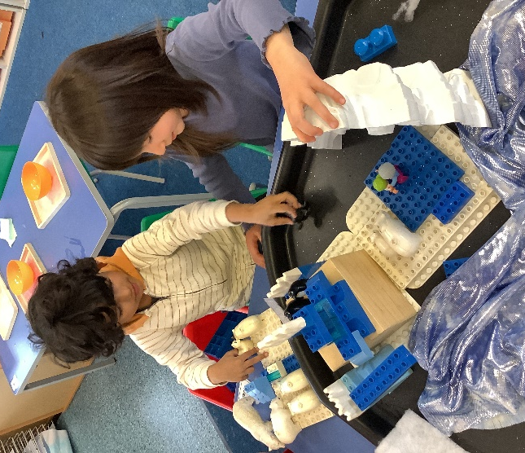
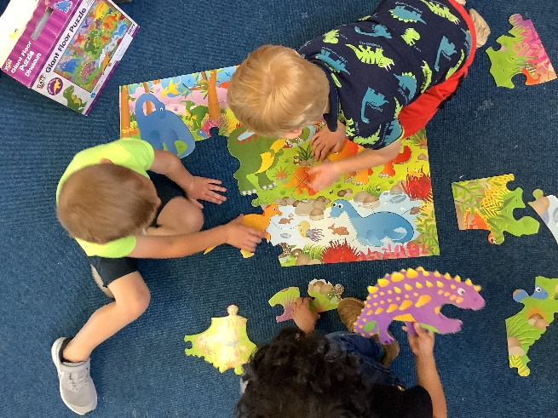
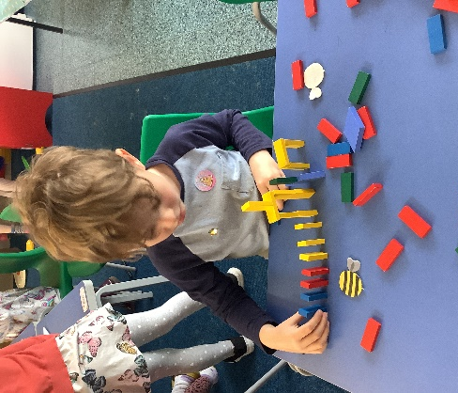
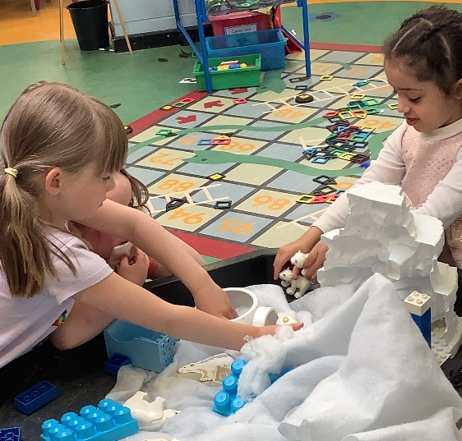
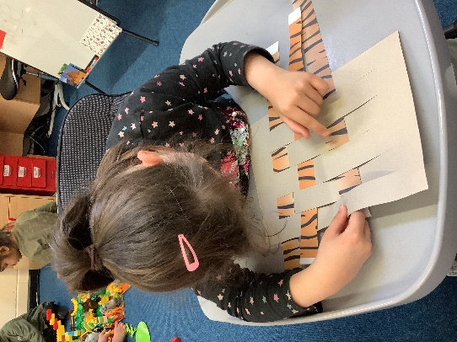
Three Prime areas
Physical Development
Physical development, Gross Motor Skills and Fine Motor Skills
Communication and Language
Listening, Attention and Understanding Speaking
Personal, Social and Emotional Development
Self-Regulation, Managing Self and Building Relationships

Slide 5
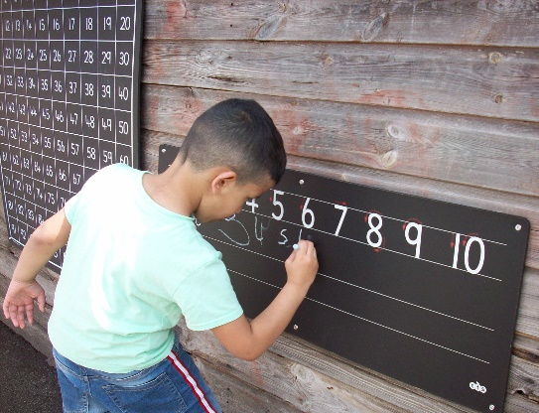
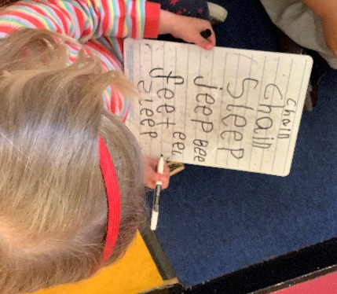
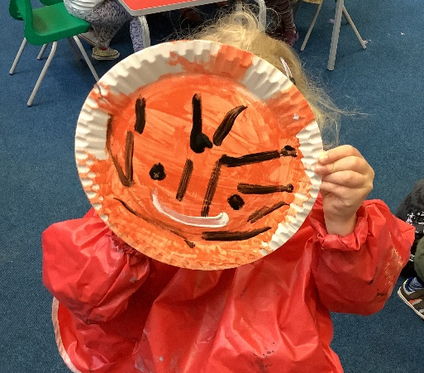
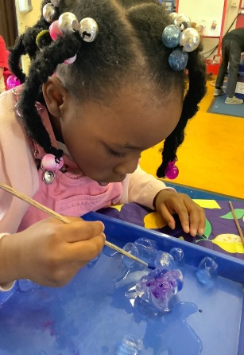
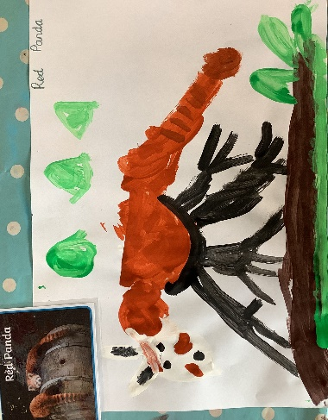
Four Specific areas
Literacy
Comprehension, Word Reading & Writing
Mathematics
Number & Numerical Patterns
Expressive Arts and Design
Creating with Materials & Being Imaginative and Expressive
Understanding the World
Past and Present,
People Culture and Communities & The Natural World

Slide 6
Assessment
At the start of the year we complete a baseline assessment for each child, this is done through a range of practical activities and observations made by staff. The baseline informs us of each child’s starting point and enables us to plan next steps.
Every child has their own Learning Journal which is shared with you each parents evening and every half term we complete a developmental check for the specific areas of learning to ensure your child is making progress.
At the end of Reception Year we assess children against the 17 Early Learning Goals as Emerging or Expected.

Slide 7
Reception Day
The Reception day begins at 8.50 a.m and register is taken at 9am
Children have snack time during the morning where the school provides water and fresh fruit.
Lunchtime is 11.45p.m.-12.45p.m Monday – Friday.
The Reception day ends at 3:25pm

Slide 8
How you can support…
Practice fine motor skills by using cutlery and scissors
Practise going to the toilet independently including wiping
Practice taking of socks and shoes and coats and practice putting them back on again. LABEL EVERYTHING
Complete puzzles and discuss shapes, go on a shape hunt
Explore mixing colours naming the different colours.
Harvest curiosity- ask questions
Practice writing their name and ensure they recognise it (on coat pegs).
Share stories- this is so important, not only because it is quality time spent together but it encourages a love of reading and develops vocabulary
Positive drop offs – create a routine, time your drop off and don’t rush.
Remember your child has had a very busy day and doesn't want to be bombarded with questions, try asking yes or no questions- Did you go outside today? Did you listen to a story today?

Slide 9
Things to bring…
A spare change of clothes (in case of accidents e.g toilet or spillages) in a small bag
A water bottle
Things to wear….
Appropriate clothing/footwear for outdoors
P.E. kit on P.E. day white t-shirt, black joggers, trainers
Please name EVERYTHING as children often do not recognise their own belongings.

